Slide 1
Extreme discharges of the Rhine and Elbe:
Design floods in the future
Jaap Kwadijk
Director of Science, Deltares
Prof. Climate and water management, Twente University

Slide 2

Who am I
1986 – MSc Quaternary Geology Amsterdam University
1993 – PhD : Effect of Climate change of the discharge of the Rhine, Utrecht University
Since 1997 Delft Hydraulics / Deltares
Currently
  Prof. Modelling climate and water management, TU.Twente
  Chair Scientific board Deltares
Floods: Netherlands, Hong Kong, Egypt, Iran, Mongolia, Surinam

Slide 3
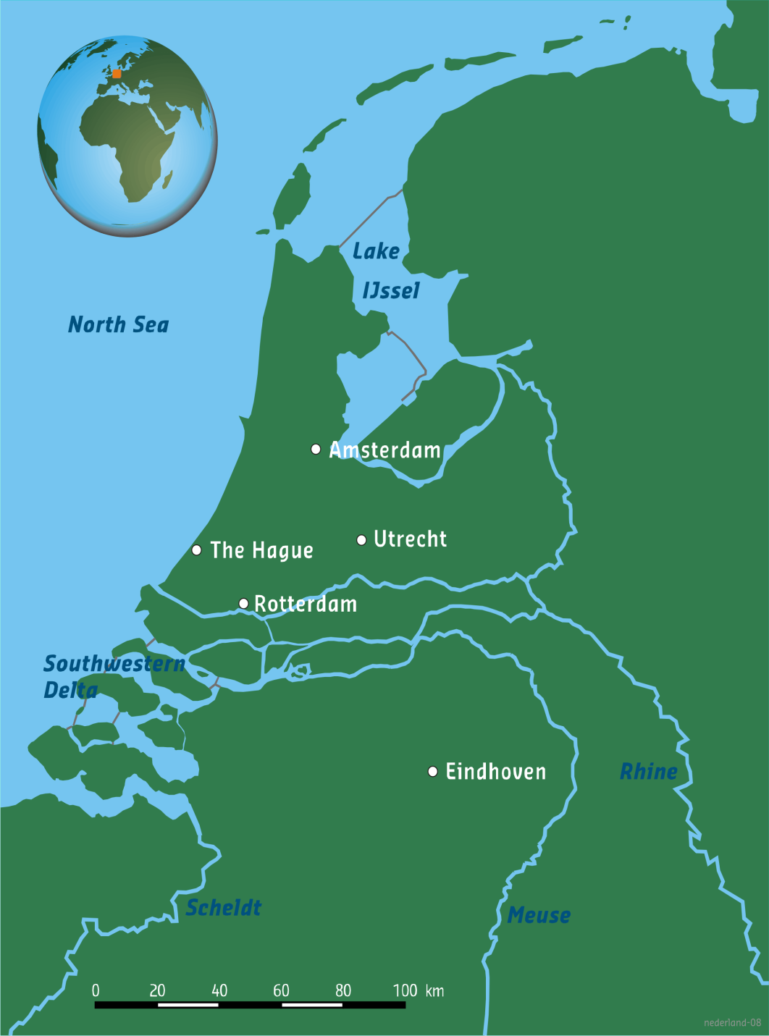
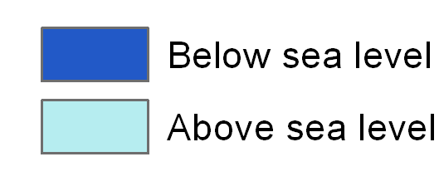
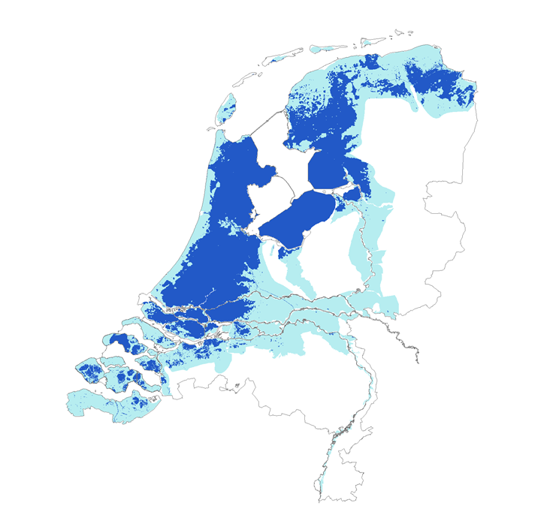
The Netherlands
2/3 flood-prone,
9 million inhabitants,
65% GNP,
€ 1800 B invested value

Slide 4
Dutch perspective: water management system are completely regulated
Notes:
We can manage nature
Strong believe in models
Strong believe in research

Slide 5
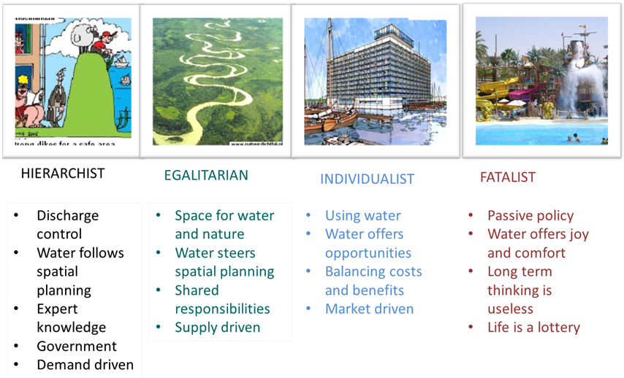

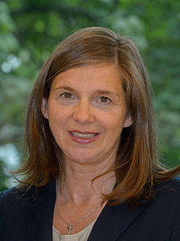




Perpectives in views and management styles
Based on Cultural Theory
The Dutch
Notes:
Werkgevers organisatie Ulrich Grillo, Präsident des Bundesverbands der Deutschen Industrie (Individualist)
Katrin Dagmar Göring-Eckardt vorsitzende Grunen (Egalitarian)
Angela Markl (??) Hierarchist

Slide 6
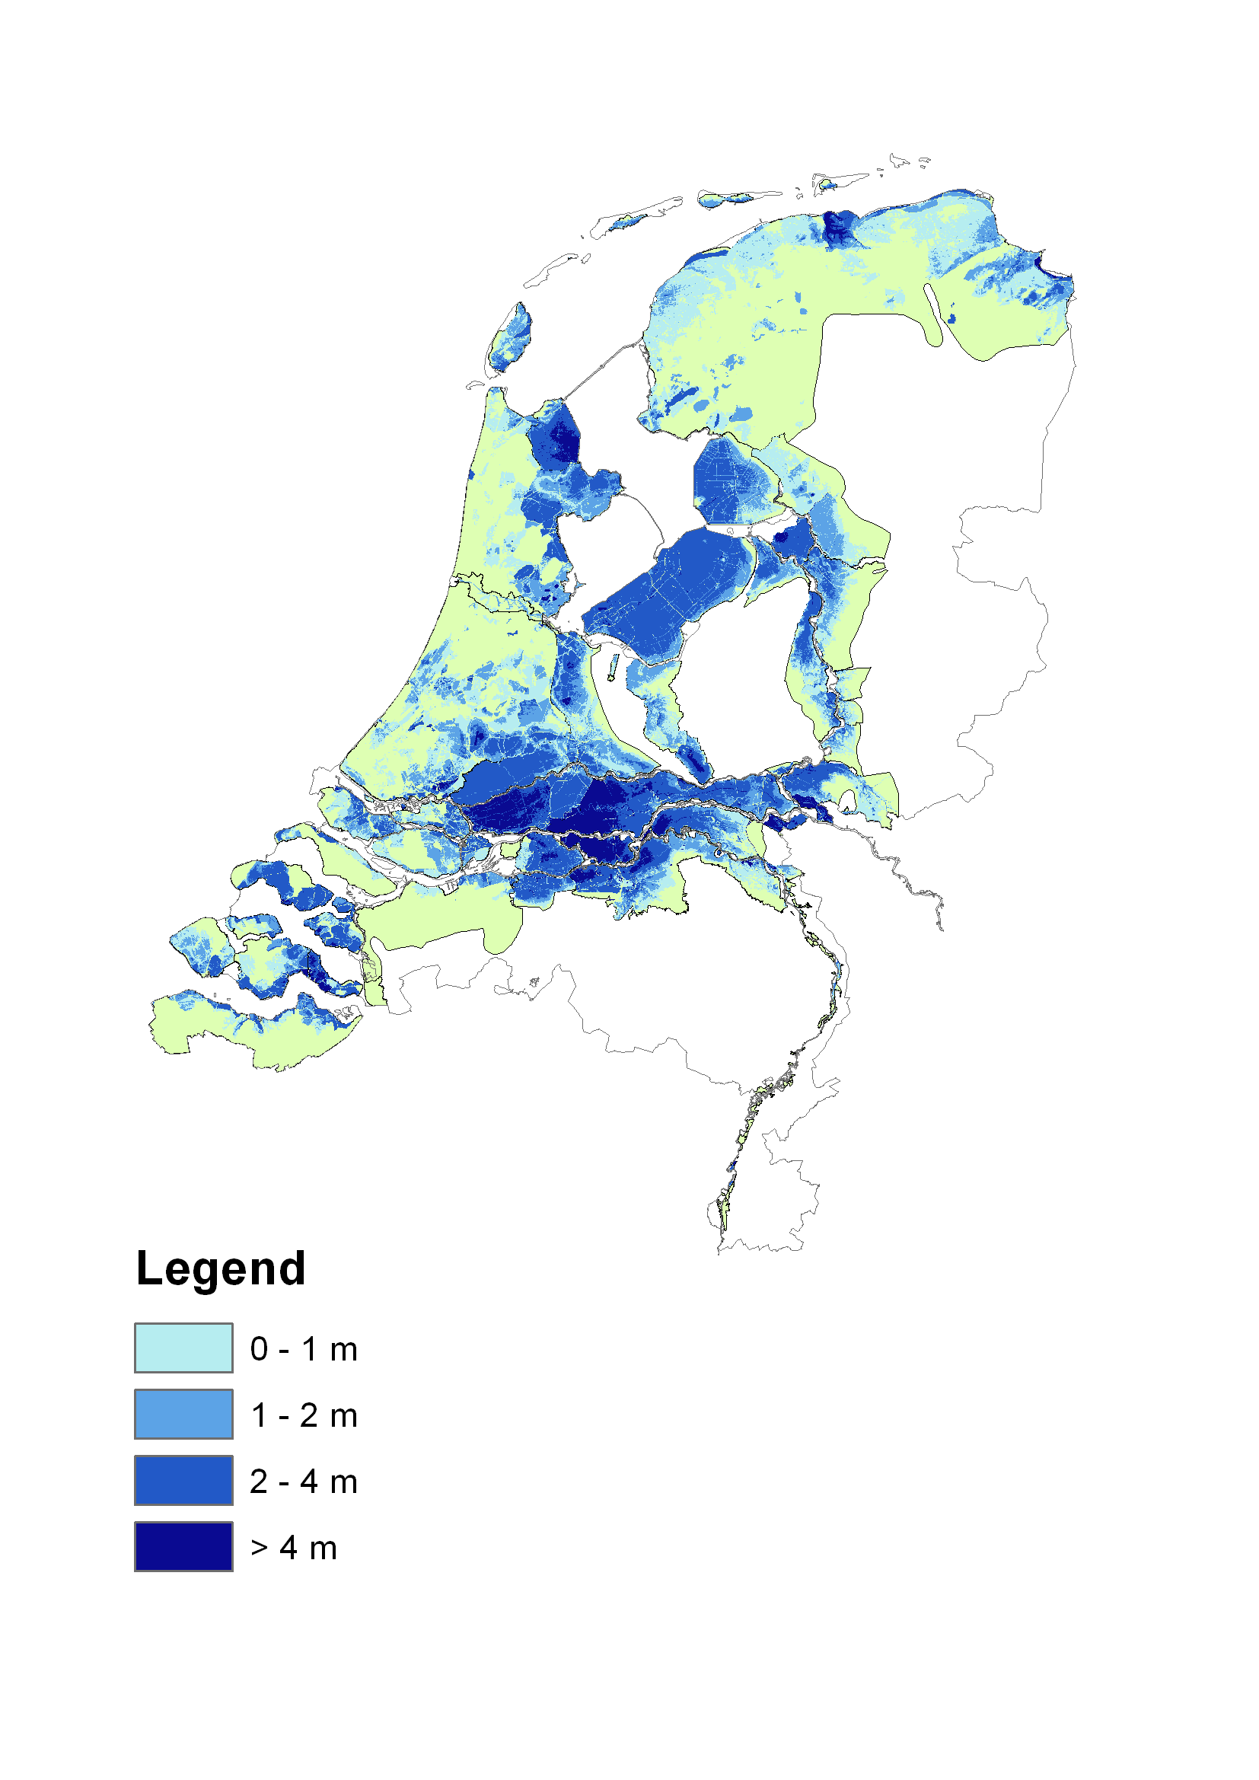
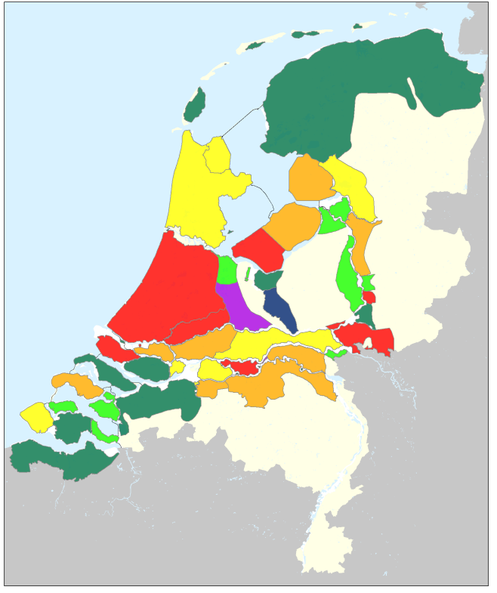
Interest is in very rare flood events
Maximum water depths
Efficient flood standards

Slide 7

The trend is towards more rare events
Climate change and subsidence of soil
Growth of
population and wealth
x
Flood probability increases
Damage by flooding increases
Expected damage increases

Slide 8
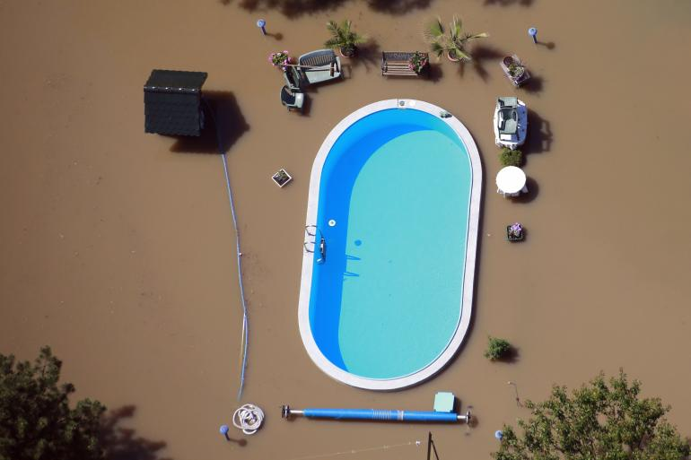
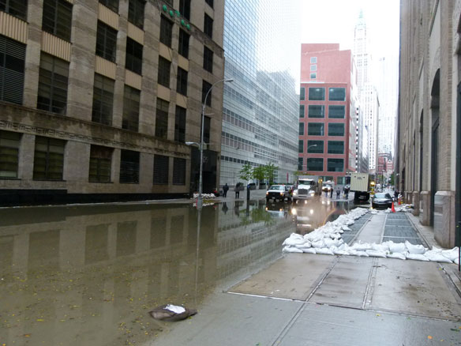
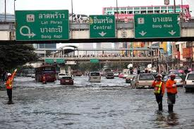
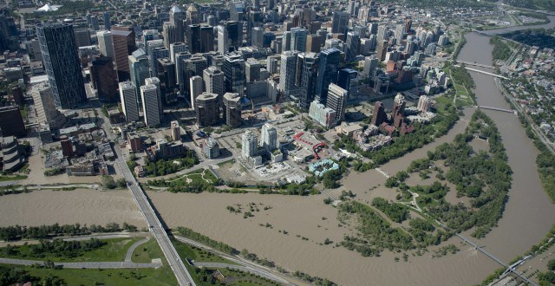
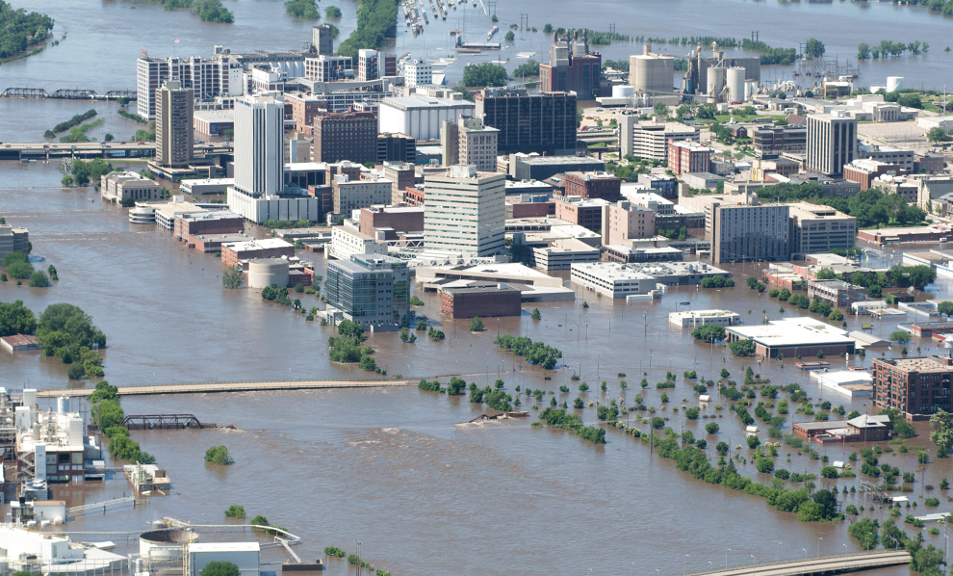
Many urban areas under-protected against floods
Hallegatte et al,
Nature CC 2013

Slide 9

“Top 20,” today, in terms of population
Courtesy, Jeroen Aerts

Slide 10
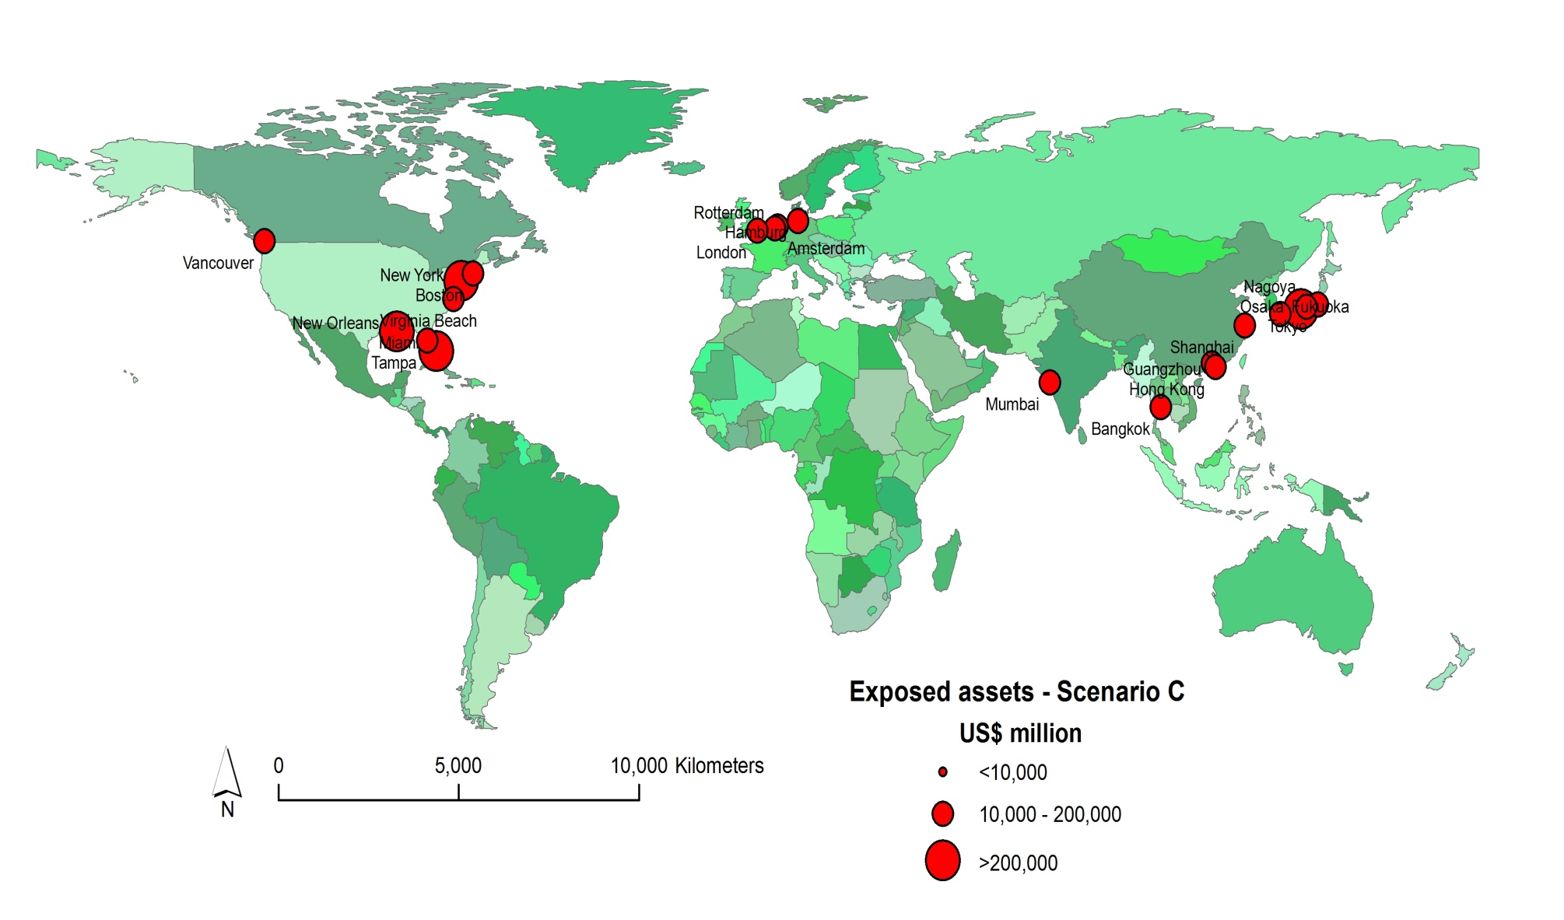
“Top 20,” today, in terms of assets
Courtesy, Jeroen Aerts

Slide 11
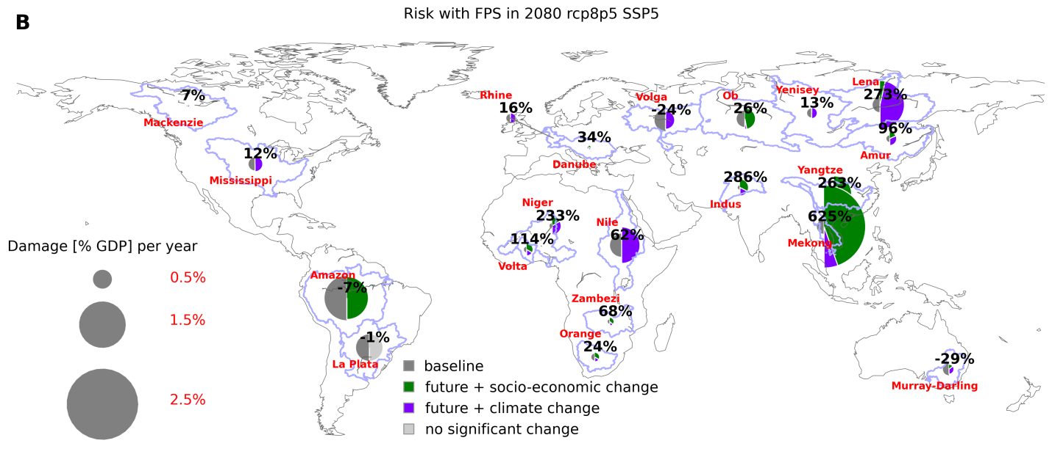
What determines growth in risk?
Hirabayashi et al. (2013): Large growth in risk in S-E Asia due to climate change; (Nature CC)
Winsemius et al. 2015: Confirms the above, but climate change impact is dwarfed by the disproportionate growth of economy in flood prone zones. Nature CC, december 2015)

Slide 12
Can we detect climate change signals in the Elbe and Rhine (not really)
Annual flows, no floods!)
Courtesy Christoph
Mudersbach
North Sea Region Climate Change Assessment (NOSCCA), in press

Slide 13
Can we detect climate change signals in the Elbe and Rhine (not really)
Belz JU et al. . Schriftenreihe der KHR, Bd. 1–22. Konlenz und Lelystad
Seasonal flows, no floods!
Courtesy CHR/KHR

Slide 14

How to solve the quest for info on more extreme events
Extrapolate your observed floods
Use others’ floods
Create your own virtual flood

Slide 15
Extrapolate your observed floods

Slide 16

Discharges
Rhine
Elbe
Find a long time series of river flows
Identify annual flow maxima
Order them from low->high
Fit an Extreme Value function through the points

Slide 18
Oder before and after 1997 flood

Slide 19

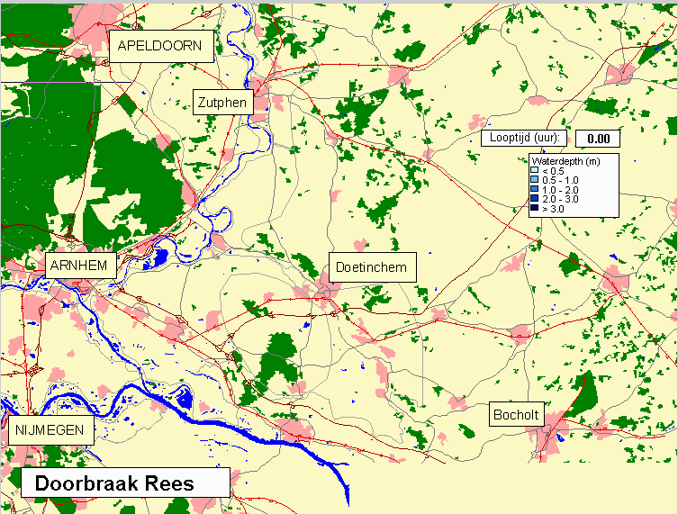
Some difficulties, larger floods may behave unexpectedly

Slide 20







Can floods become inifitely large?
Can chickens become as big as ostriches???
(they could according to the extrapolation theory)

Slide 21
Use others’ floods to increase your own knowledge
From: Helmus vd Langemheen (RIZA), Jeanet Onvlee, Gunther Konnen (KNMI), Jaap Schellekens (Deltares)

Slide 22
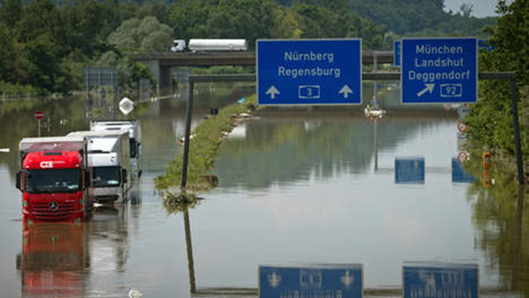
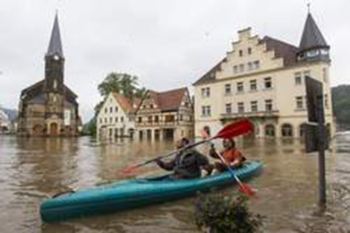
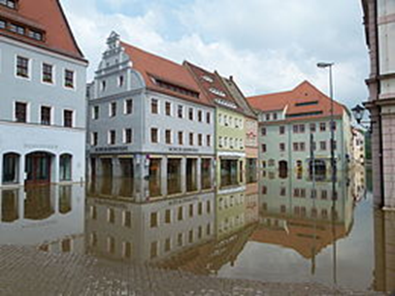
Projection of the Elbe 2002 flood on the Rhine basin

Slide 23
Shift the output of a weather forecast model (HIRLAM)

Slide 24
Different translation scenario’s
Shift the:
Rainfall pattern 3 degrees towards the west.
Rainfall pattern 4 degrees towards the west.
Rainfall pattern 5 degrees towards the west.and 0.5 degree towards the south
Rainfall pattern 6 degrees towards the west.and 1 degree towards the south
(1 degree E is approximately 68 km; 1 degree S is approximately 100 km)

Slide 25
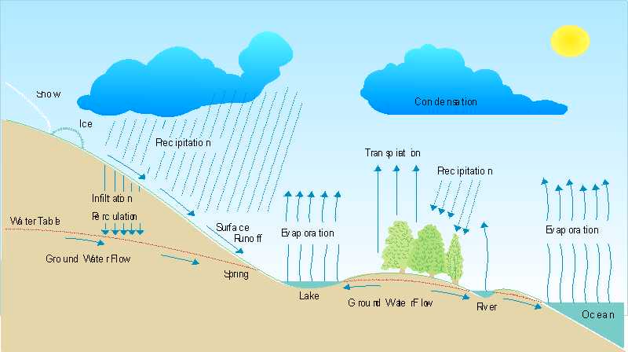
Translate rainfall into river flow

Slide 26
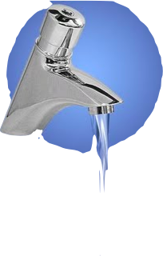




From the hydrologists perspective :
Rainfall
Evaporation
Storage
River flow

Slide 27
Results

Slide 28
Result
Rainfall more than 20% higher then during the floods of 1993, 1995 (no 2 an 3 of the 20th century)
But the resulting flow in the Rhine was less then in 1993 and 1995
=> would not lead to flooding in The Netherlands
Why??
The Elbe event happened in summer => rain falls on relatively dry soils (the sponge)
This soil will become more wet, that water will not end up in the river, relatively little water will end up in the river
So lower floods
However: for summer conditions it resulted into an extremely high flood

Slide 29
Why are the consequences so very different
Mainly difference in protection levels (Netherlands typically 1000 year flood (or even more); Germany 500 year flood (or less)

Slide 30
Create your own virtual floods
Use weather generators
Use weather prediction products

Slide 31
Weather generator
Digital maps of daily observed weather Temperature and rainfall
1961-2000
n-year sequence of daily rainfall and temperature patterns
(synthetic series)
statistical analysis of daily autocorrelation (persistence of the weather)

Slide 32
Time series resampling
Historical precipitation
5 | 1 | 0 | 2 | 20 | 10 | 0 | 5 | 30 | 0
Rain volume (mm)
5 | 1 | 0 | 2 | 20 | 10 | 0 | 5 | 30 | 0
5 | 1 | 0 | 2 | 20 | 10 | 0 | 5 | 30 | 0
5 | 1 | 0 | 2 | 20 | 10 | 0 | 5 | 30 | 0
5 | 1 | 0 | 2 | 20 | 10 | 0 | 5 | 30 | 0
5 | 1 | 0 | 2 | 20 | 10 | 0 | 5 | 30 | 0
5 | 1 | 0 | 2 | 20 | 10 | 0 | 5 | 30 | 0
5 | 1 | 0 | 2 | 20 | 10 | 0 | 5 | 30 | 0
5 | 1 | 0 | 2 | 20 | 10 | 0 | 5 | 30 | 0
5 | 1 | 0 | 2 | 20 | 10 | 0 | 5 | 30 | 0
5 | 1 | 0 | 2 | 20 | 10 | 0 | 5 | 30 | 0
5 | 1 | 0 | 2 | 20 | 10 | 0 | 5 | 30 | 0
Simulated precipitation
0
5
1
20
10
30
10
0
0
0
Rain volume (mm)
0 | 5 | 1 | 20 | 10 | 30 | 10 | 0 | 0 | 0 | …

Slide 33
Time series resampling
Historical precipitation
5 | 1 | 0 | 2 | 20 | 10 | 0 | 5 | 30 | 0
Volume (mm)
5 | 1 | 0 | 2 | 20 | 10 | 0 | 5 | 30 | 0
Largest 4 day sum 45 mm
Simulated precipitation
0 | 5 | 1 | 20 | 10 | 30 | 10 | 0 | 0 | 0 | …
0 | 5 | 1 | 20 | 10 | 30 | 10 | 0 | 0 | 0 | …
Largest 4 day sum : 70 mm

Slide 34
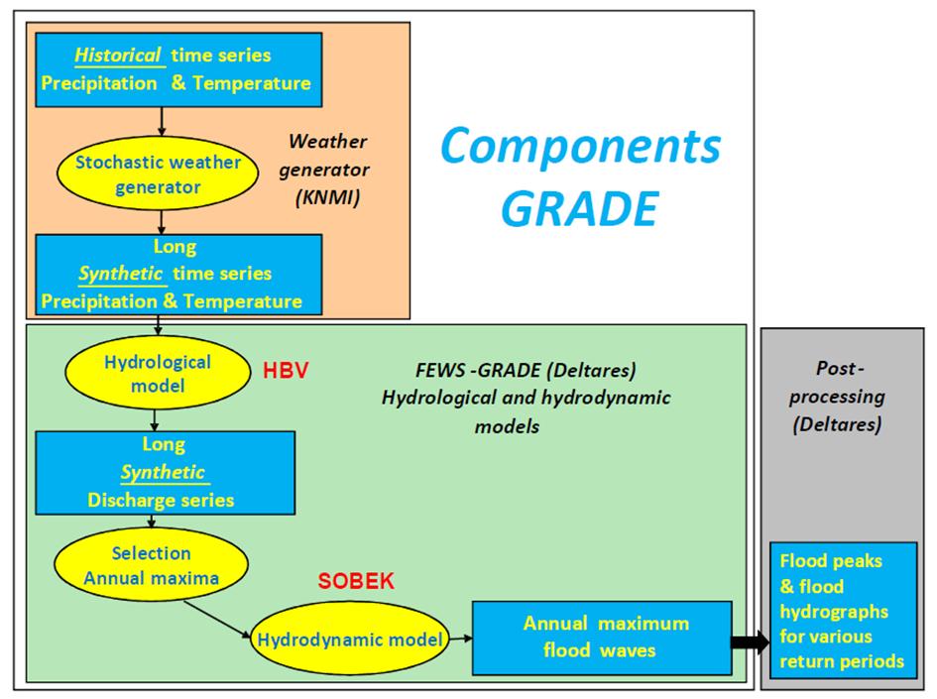

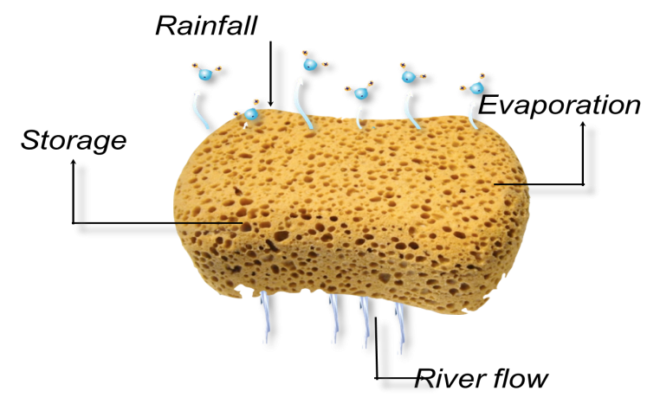
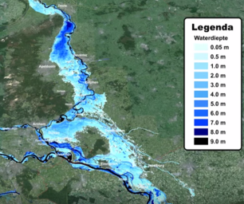

Slide 35
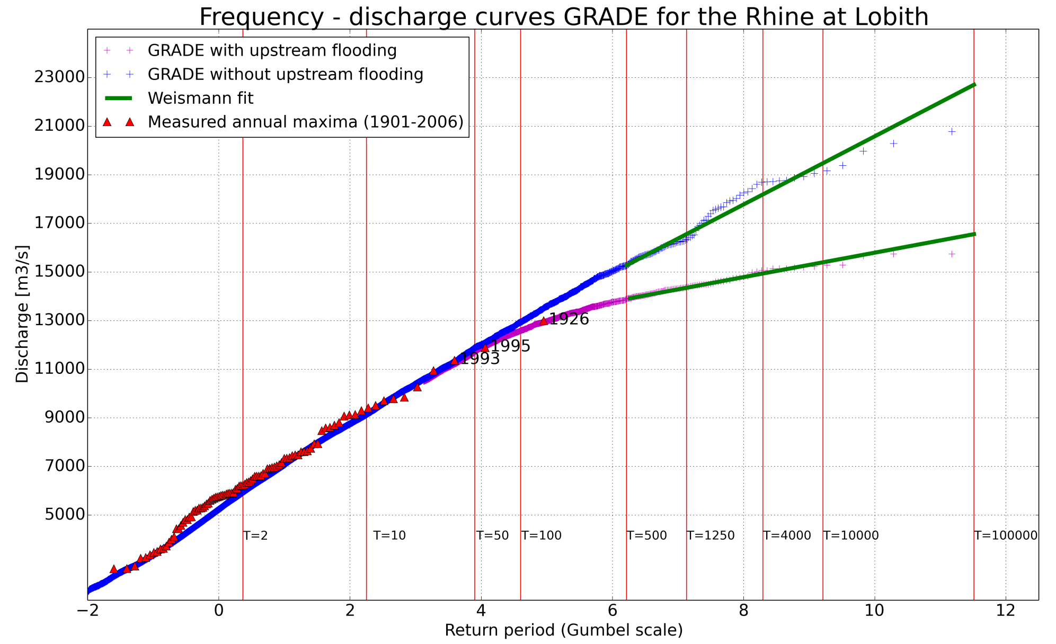
Result: estimation of very extreme discharges

Slide 36
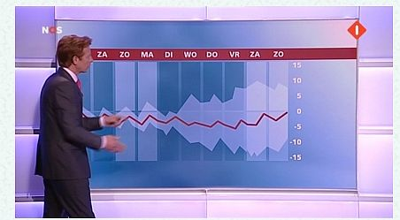
Use products of the weather prediction models

Slide 37
2x per day 50 equally possible weather maps

Slide 38
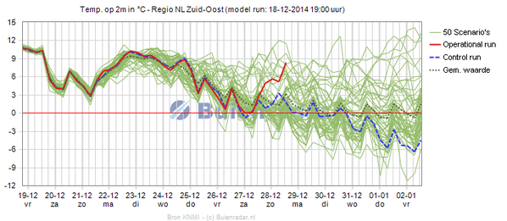
=> From this 50 rainfall and temperature predictions

Slide 39
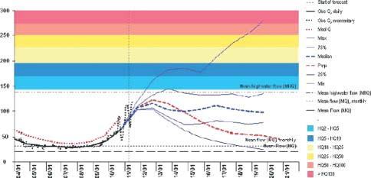
From this also 50 possible river flows

Slide 40
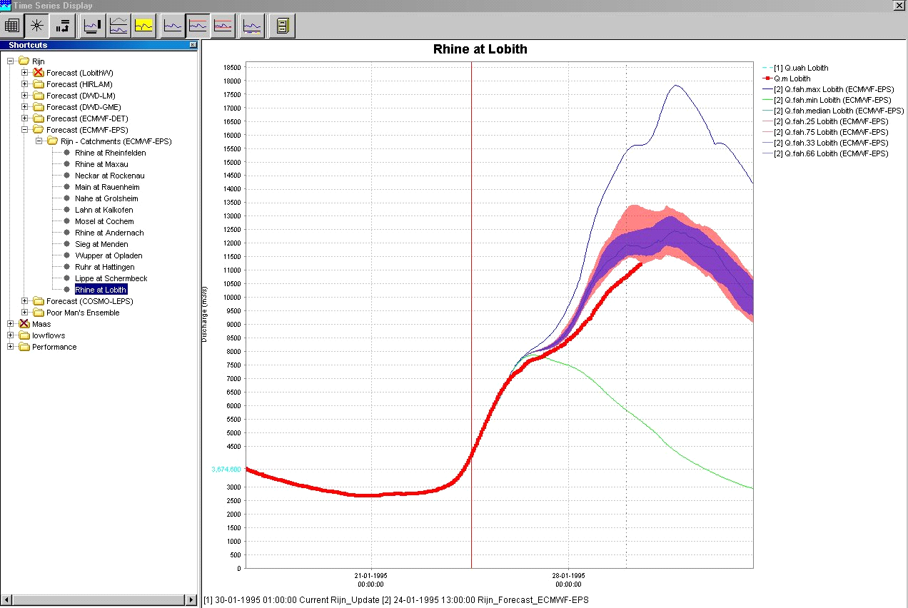
Around each annual maximum flood 50 additional possible floods (example 1993) => more info

Slide 41

Advantage: we can show what the weather is that leads to such extreme events

Slide 42
In a nutshell
The interest will focus to the protection to increasingly rare flood events
Extrapolation methods are of limited value for preparing and design, they do not increase understanding
Weather-discharge-flood generators provide more accurate information about return periods of very extreme floods, increase the understanding
Additionally ensemble weather predictions can provide understandable information since a weather anchor man/woman can tell us about the weather that will lead to such events, also increase our understanding
But… I do not understand the characteristics and consequences of 100,000 years flood these remain beyond my imagination (are the natural sciences able to achieve this??)

